Slide 1

SQl user define functions & CASE
Maziar Shajari – April 2020

Slide 2
SQL User-defined functions (UDF)
Like functions in programming languages, SQL Server user-defined functions are routines that accept parameters, perform an action, such as a complex calculation, and return the result of that action as a value. The return value can either be a single scalar value or a result set.
You can create the function once, store it in the database, and call it any number of times in your program. User-defined functions can be modified independently of the program source code.
They allow faster execution
They can reduce network traffic.

Slide 3
Scalar value functions
use AdventureWorks2017
Go
create function UDF_AverageTwoNumbers (@var1 as decimal, @var2 as decimal)
returns Decimal (5,2)
as
begin
return ((@var1 + @var2)/2)
end
Go
select dbo.UDF_AverageTwoNumbers (3,10)
Input Variables

Slide 4
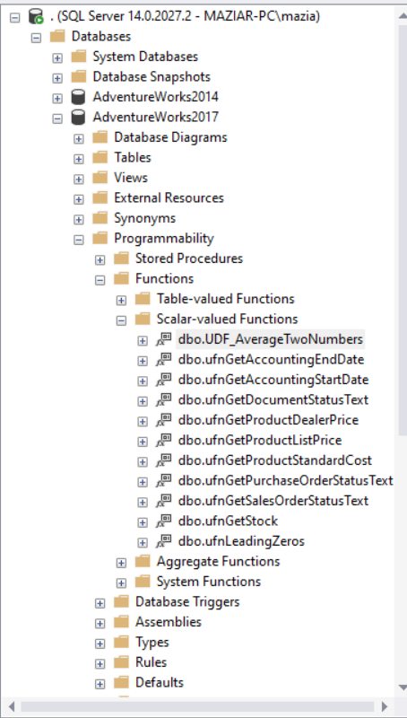
Delete Function
drop function dbo.UDF_AverageTwoNumbers

Slide 5
Facts about the user define functions:
User-defined functions cannot be used to perform actions that modify the database state.
User-defined functions can not return multiple result sets. Use a stored procedure if you need to return multiple result sets.

Slide 6
CASE Command
CASE WHEN condition1 THEN result1 WHEN condition2 THEN result2 WHEN conditionN THEN resultN ELSE result END;
select ProductID, name, Color ,
case
when color = 'red' then 'The color is red'
when color = 'Black' then 'Not a good color'
when color = 'pink' then 'Yekta likes it'
when color = 'purple' then 'Yekta likes it'
Else 'Color not categorized'
end as Colortype
from Production.Product
where color is not null
https://www.w3schools.com/sql/sql_case.asp

